Slide 1
Environmental Education
Environmental Education is the study of the interaction of living things with the natural environment
The environment includes all conditions that surround living organisms:
Climate
Air and water quality
Soil and landforms
Presence of other living organisms

Slide 2
As per Environment (Protection) Act 1986,
“ The sum total of water, air and land, the inter-relationships that exist among them and with the human beings , other living organisms & materials.”

Slide 3
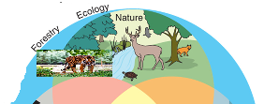

Slide 5
Indian Culture is based on Principles of environmental Conservation
The concept of keeping forest reserves was first developed by Kautilya, an Indian scholar in the past.
Trees of different Nature are protected and preserved as sacred groves in most parts of the country.
Our Vedas are enriched with values of Sun, Water, Mountains, Rivers, Animals.
There is an unparalleled example of “Chipko Movement” in 1973 for Khejri tree.

Slide 6
Ecology is the scientific study of the distributions, abundance, and relations of organisms and their interactions with the environment.
Ecology includes the study of plant and animal populations, plant and animal communities, and ecosystems.
Ecosystems describe the relations among organisms at different scales of organization. Since ecology refers to any form of biodiversity, ecologists research everything from tiny bacteria's role in nutrient recycling to the effects of tropical rainforest on the Earth's atmosphere. The discipline of ecology emerged from the natural sciences in the late 19th century.

Slide 7
Environmental Sustainability
Environmental Sustainability – the ability of the environment to function indefinitely without going into a decline from the stresses imposed by human society on natural systems (soil, water, air) that maintain life.

Slide 8
Air pollution occurs when harmful or excessive quantities of substances including gases, particulates, and biological molecules are introduced into Earth's atmosphere

Slide 9
Water pollution is the contamination of water bodies, usually as a result of human activities.

Slide 10
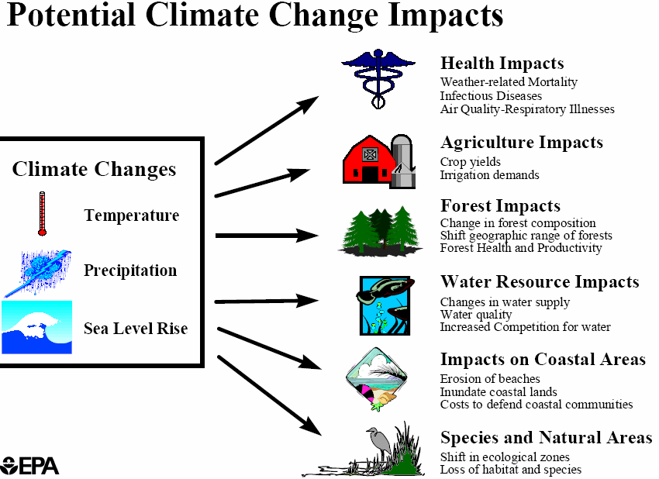

Slide 11
Soil Pollution

Slide 12
Thanks for watching
Save Environment Save future

